Slide 1
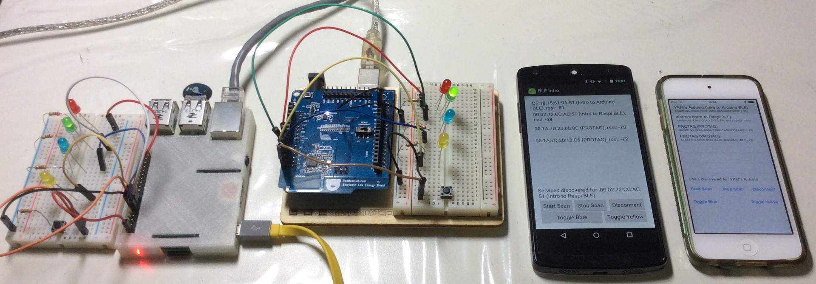
Introduction to Bluetooth Low Energy (BLE)
with
SP Digital Tech Talk (8 June 2017)
iOS Dev Scout (23 June 2016)
Tech Talk Tuesdays @OMG (16 Feb 2016)
Friday Hacks #98 @NUS Hackers (2 Oct 2015)
Hackware v0.8 (9 June 2015)
Hackware v0.7 (13 May 2015)
Hackers and Painters (10 April 2015)
By: Yeo Kheng Meng (yeokm1@gmail.com)
https://github.com/yeokm1/intro-to-ble

Slide 2
Demo

Slide 3
About Me
Graduated from NUS Computer Science in 2015
Worked in 2 BLE-related startups before

Slide 4


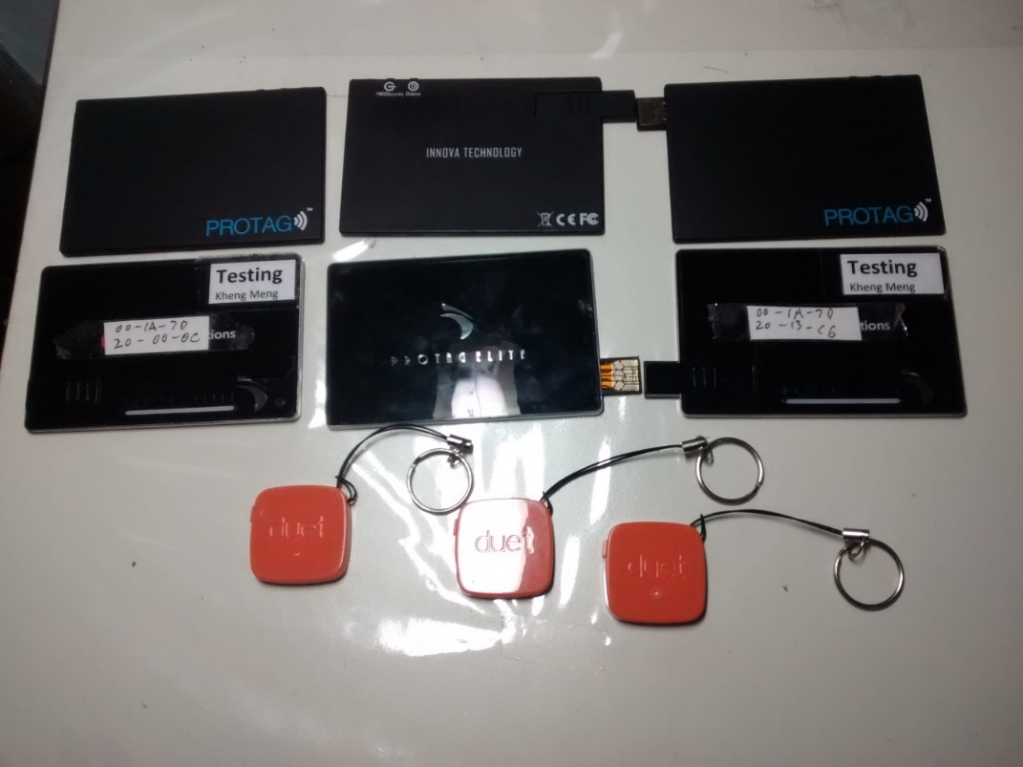
Where I started from?
Innova Technology
Anti-loss BLE tags with companion phone app
“Protags”
Android Dev
2013 – 2014
Era before Android officially supported BLE
Fragmentation like you have never seen

Slide 5

Before SP?
Algoaccess
Med-tech startup: targeting at eye-professionals
Help them to retrieve, manage and process the data
Roles: many….
2014 - 2016

Slide 6
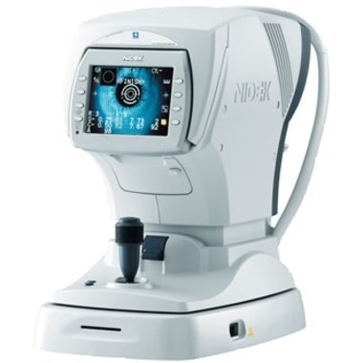
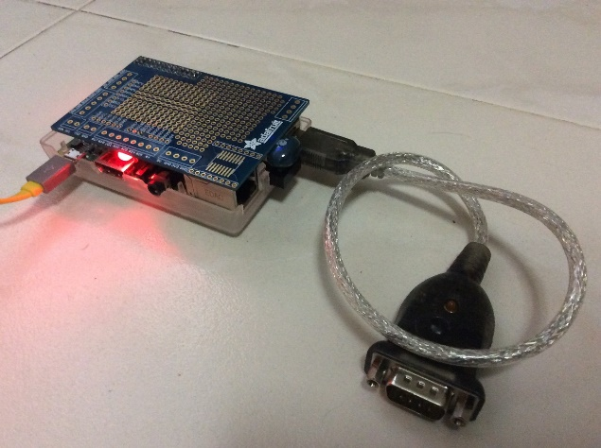
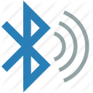
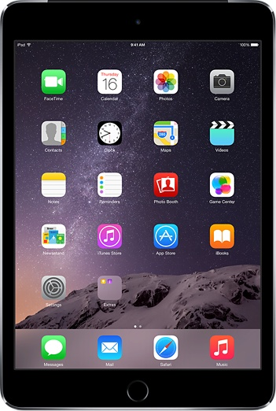

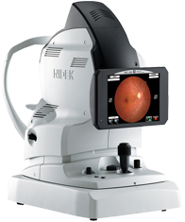
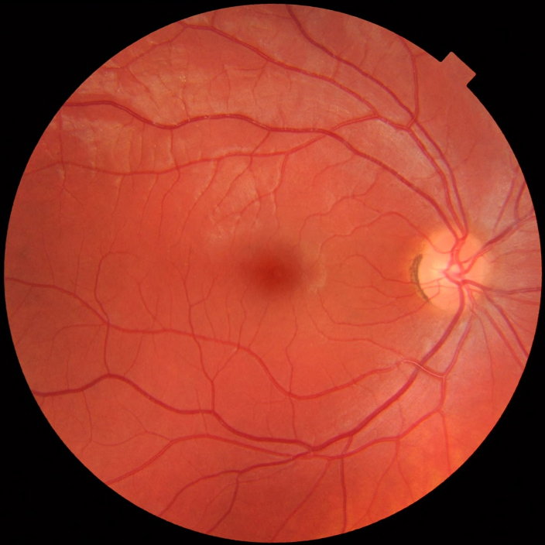
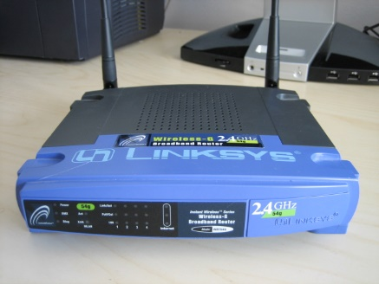
How things work?
OD, OS, CYL…
OD, OS, CYL…

Slide 7
Intro: Bluetooth Classic
The “conventional” Bluetooth
2.4GHz
Range: 1m - 100m (10m typical)
Connection-oriented: audio, file transfer, networking
Reasonably fast data rate: 2.1 Mbps
Power consumption:
Not satisfied with < Wifi < 3G

Slide 8

Intro: BLE
Introduced in Bluetooth 4.0 specification (2010)
Also known as
Bluetooth SMART
Single-Mode
Dual-Mode = Classic + Single-Mode
Target applications
Wireless battery-powered sensors eg. heart rate, thermometer, fitness
Location tracking and information serving eg. iBeacons
Requirements for target applications
Low-power
Low-cost
Low bandwidth: ~100 kbps
Low latency: Connectionless (fast setup and teardown of connection in ~10ms)
How?
Radio chip off most of the time
Small packets
MTU: 20 bytes/packet for application
Less time transmitting -> less heat -> no need compensatory circuits -> save more power

Slide 9
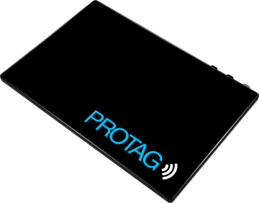
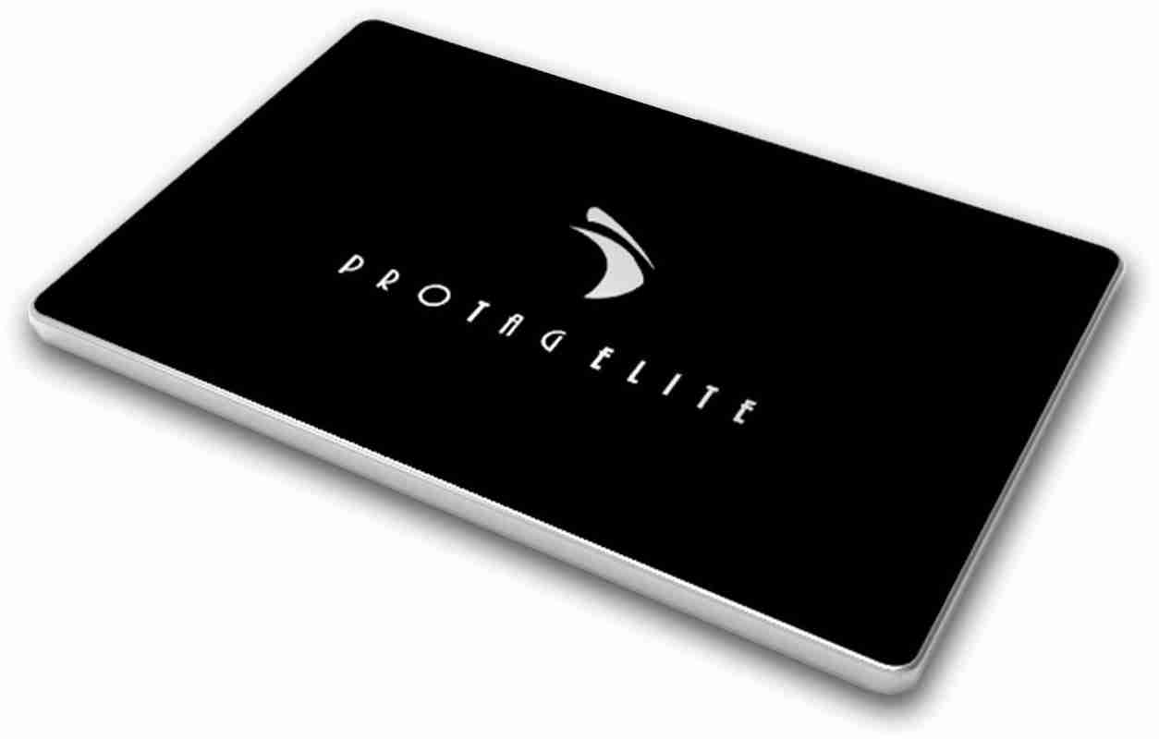
Bluetooth Classic vs SMART
An actual battery-life comparison
Innova’s anti-loss products
vs
Protag G1 (Classic)
Released: 2012
Battery Capacity: 3.7V, 270mAh
Battery Life: 1 - 2 weeks
Protag Elite (SMART)
Released: 2013
Battery Capacity: 3.7V, 150mAh
Battery Life: 6 months to 1 year

Slide 10
Wireless constraint triangle
Speed↑
Range↑
3G/4G
802.11 n/ac
5Ghz
802.11 b/g/n
2.4Ghz
SSN/Lora
BT Classic
Other factors not mentioned
Cost
Royalties
Manufacturing
Adoption rate
Topology support
Mesh
Star
Zigbee
BLE
RFID/NFC
Power usage ↓
*Positions are for relative comparison only, they are not absolute

Slide 11
What’s on the agenda?
BLE theoretical concepts*
Device Role 1: Broadcaster vs Observer
Device Role 2: Central vs Peripheral
OS/Device Compatibility
UUID, Attribute, GAP, GATT, Service, Characteristic, Descriptor
BLE connection procedure
Peripheral hardware design and software planning
Functional requirements
Hardware setup
Peripheral architecture plan
Execution
Arduino (C)
Central architecture plan (iOS and Android)
iOS (Swift)
Raspberry Pi (JavaScript)
Android (Java)
Issues and tips
General issues
iOS
Android (past, today, production app tips)
BLE layer model and packet concepts
BLE Sniffer
Further reading
Extra questions
* Exact definitions are not used to aid ease of explanation

Slide 12
1a. Device Role 1: Broadcaster vs Observer
Observer 1
Advertises
Broadcaster 1
Observer 2
Broadcaster 2
Observer 3
aka Beacon-mode
One-way advertisement information transfer from broadcaster to observer(s)

Slide 13
1b. Device Role 2: Central vs Peripheral
Advertises
Central
Peripheral
Connects to
Platform | Terms they prefer (generally mean the same thing)
iOS | Central/Peripheral
Android | Client/Server
Chipset manufacturers | Master/Slave

Slide 14
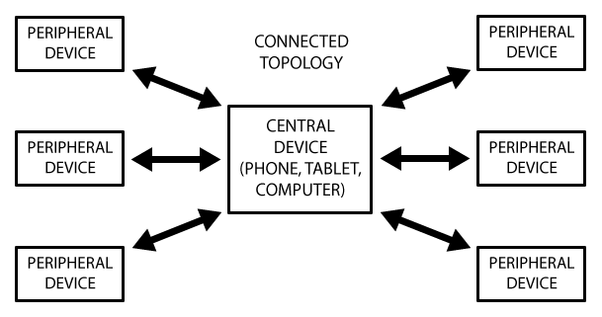
1b. Device Role 2: Central vs Peripheral
Source: https://learn.adafruit.com/assets/13826
Central can connect to many peripherals at the same time
Peripheral can connect to only one central at any one time.

Slide 15
1c. OS/Device Compatibility
Observer/Central | Broadcaster/Peripheral
iOS 5 Windows 8 Mac OS X 10.7 (Lion) Linux kernel 3.5 Bluez 5.0 Android 4.3 (Jelly Bean MR2) X - Nexus 7 (2012), 10* X - Galaxy Nexus* Hardware chipsets CC2540 CSR1010 NRF51/52 | iOS 6 Windows 10 Mac OS X 10.9 (Mavericks) Linux kernel 3.5 Bluez 5.0 Android 5.0 (Lollipop) X - Nexus 4, 5, 7 (2013)* ✔ - Nexus 6, 9, 5X, 6P, Pixel… Hardware chipsets CC2540 CSR1010 NRF51/52 NRF8001
*Hardware capable but not certified by Bluetooth SIG-> disabled in OS
, custom ROMs may enable these BLE features

Slide 16
1d. UUID, Attribute
Universally Unique Identifier (UUID)
128-bit eg. “12345678-ABCD-EF90-1234-00805F9B34FB”
To ensure practical uniqueness if randomised
2¹²⁸ = 3.4 x 10³⁸
16-bit for Bluetooth Special Interest Group (SIG) defined services/characteristics/descriptors
Combined inside Bluetooth Base UUID
0000xxxx-0000-1000-8000-00805F9B34FB
Attribute
Anything that has a UUID
Refers to Services, Characteristics and Descriptors

Slide 17
1d. GAP, GATT (defined by Peripheral)
Generic Access Profile (GAP) or Advertising
Information advertised to central before connection
Name of peripheral
Is it connectable?
Supported features (services)
Generic Attribute Profile (GATT)
How to exchange data once connected
Identifies Services, Characteristics and Descriptors
*Both GAP and GATT are theoretical concepts, you don’t usually see those terms in coding APIs.

Slide 18
1d. Service, characteristic, descriptor (All these are part of a peripheral’s GATT)
Service
16-bit SIG services: Battery, Heart rate, Immediate Alert, Tx Power
128-bit UUID for custom services
Collection of characteristics
Characteristic
Holds a value: String, Int, Char…..
Can take on multiple properties:
Read: Central can read this value directly
Write: Central can write/change this value and be notified if executed successfully
WriteWithoutResponse: Central just “fire and forget”
Notify: Central gets alerted if the value has changed
Others: Broadcast, Indicate, SignedWrite, QueuedWrite, WritableAuxiliaries
Collection of optional descriptors
Descriptor: usually optional
Holds a value
Used to describe a characteristic (meta-data)
Special case: Client Characteristic Configuration Descriptor (0x2902)
Usually automatically created for characteristics with “notify” property

Slide 19
1d. Service, characteristic, descriptor
GATT
Service1
Service2
Characteristic1
Properties: Read, Notify
Characteristic1
Properties: Read, Write
Descriptor1
Characteristic2
Properties: WriteWithoutResponse
Descriptor1
Descriptor2

Slide 20
1e. BLE connection procedure
Central
Broadcaster
Observer
Peripheral
1. Scanning
Broadcasts advertisement packets (GAP)
Advertising
2. Received advertisement packet (Stop here for beacon devices)
2.5. Connection attempt
Connected success, stops advertising
Connect success
3. Connect success,
now lets find out more
Discover services
Send back services info
Services data (GATT)
4. Services discovered, lets dig deeper
Discover characteristics
Send back characteristics info
Characteristics data (GATT)
5. Discovery completed, ready to use peripheral
Discover descriptors (usually optional)

Slide 21
2a. Functional Requirements
Connection Status
Red LED to indicate no connection
Green LED to indicate active connection with central
Controllable via BLE
Let central toggle blue LED
Let central toggle yellow LED
Button to trigger sending data back to central

Slide 22
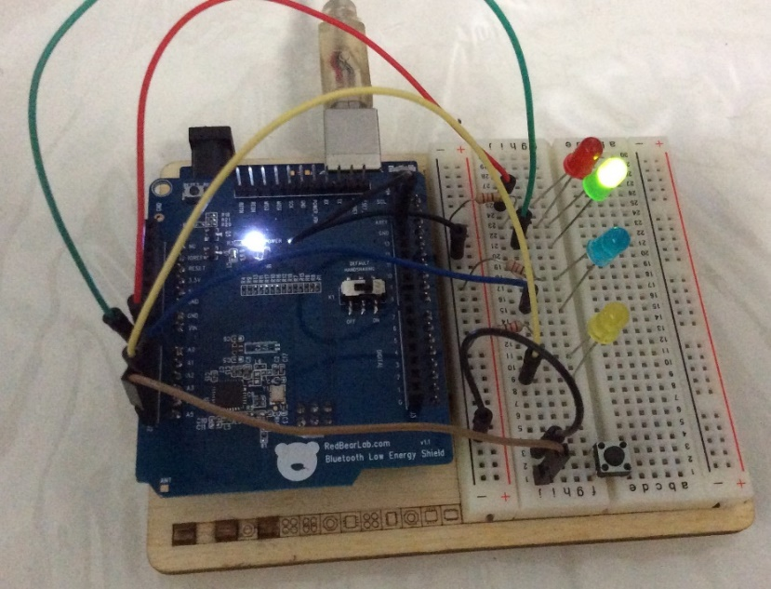
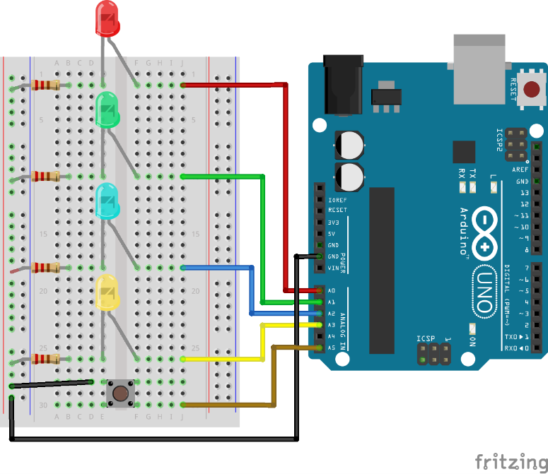
2b. Hardware setup (Arduino)
Arduino Parts list
Arduino Uno R3
RedBearLab BLE (Single-Mode) Shield v.1.1
(Not shown in schematic)
NRF8001 chipset
Red LED
Green LED
Blue LED
Yellow LED
4x 220ohm resistors
Push Button

Slide 23
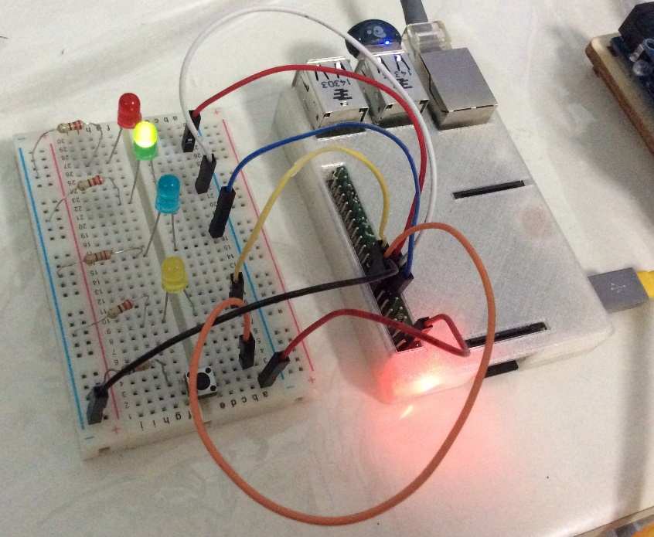
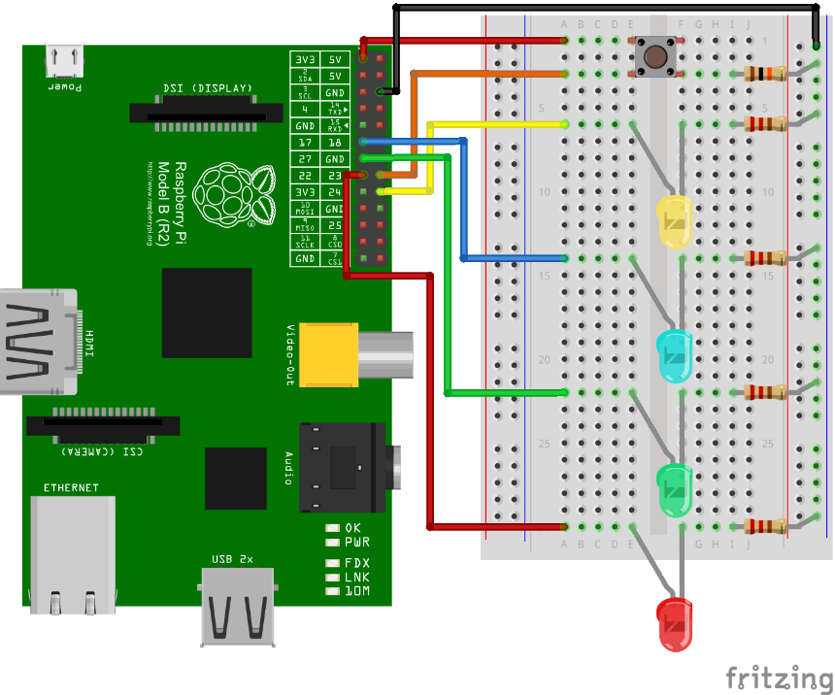
2b. Hardware setup (Raspberry Pi)
Raspberry Pi Parts list
Raspberry Pi 3 Model B
IOGear GBU521 USB BLE (Dual-Mode) adapter
BCM20702 chipset
Red LED
Green LED
Blue LED
Yellow LED
4x 220ohm resistors
Push Button
10k ohm pull-down resistor

Slide 24
2. Peripheral Architecture Plan
Generic Access Profile (GAP)
Field | Value
Device name (general) | YKM’s Arduino (Not accessible via Android APIs)
Local name (specific): | Intro to Arduino BLE
isConnectable | Yes
Services | 1 service: UUID = "12345678-9012-3456-7890-123456789012“
Generic Attribute Profile (GATT)
Service 1 (UUID : "12345678-9012-3456-7890-123456789012“)
Characteristic 1 (LED)
Value type: char (1-byte character)
UUID : “00000000-0000-0000-0000-000000000010”
Properties: Read, WriteWithoutResponse
Characteristic 2 (Button)
Value type: String
UUID : “00000000-0000-0000-0000-000000000020”
Properties: Read, Notify
LED characteristic
Toggles blue LED if central writes “b”
Toggles yellow LED if central writes “y”
Button characteristic
Notifies central if button is pressed
Sends back incrementing number

Slide 25
3a. Arduino code
Programming Language: C
Arduino IDE 1.8.2
Libraries Used
ble-sdk-arduino for NRF8001 (By Nordic)
https://github.com/NordicSemiconductor/ble-sdk-arduino
arduino-BLEPeripheral (By Sandeepmistry)
Abstraction over ble-sdk-arduino
https://github.com/sandeepmistry/arduino-BLEPeripheral

Slide 26
3b. Central architecture plan (iOS and Android)
BLEHandlerCallback** Interface/Delegate
Returns results*
implements
MainActivity/ViewController
(UI)
BLEHandler
(Deals with platform’s BLE APIs)
Calls functions
*BLE APIs are asynchronous in nature.
**Use BLEHandlerCallback to avoid tight coupling between UI and BLEHandler

Slide 27
3c. iOS Code
Platform
Device: iPod Touch 6G
iOS 10
Programming Language: Swift 3
Xcode 8

Slide 28
3b. Raspberry Pi code
Platform
Device: Pi 3 Model B*
OS: Raspbian
Programming Language: Javascript
Framework used: Nodejs
Nodejs BLE Library
Bleno (by Sandeepmistry again)
Abstraction over Linux’s Bluez stack/API
Aggressive maintenance
https://github.com/sandeepmistry/bleno
Why not others, Python, Go or C?
Bleno is more “mature” and “easier to use”
*Others will work too

Slide 29
3c. Android code
Platform
Device: Nexus 5
Android 6 (maximum)
Programming Language: Java
Android Studio 2.3

Slide 30
4a. General Issues
Limit data transfer to 20-byte chunks
Peripheral
Characteristics support UTF-8 values
I use ASCII for Arduino compatibility, but UTF-8 is generally safe
Central
Must rescan upon Bluetooth/phone restart
Existing CBPeripheral (iOS) and BluetoothDevice (Android) references becomes invalid
iOS/Android simulator cannot be used

Slide 31
4b. iOS issues
Cannot retrieve Mac Address (without private APIs)
Generated UUID specific to iOS device
Identification issues across iOS devices /Android
Solution: Peripheral embeds Mac Address in advertisement (GAP) data
Manufacturer data field (Innova Technology)
In device/local name fields (Algo Access/SP)
Aggressive caching of GATT data
Receive out-of-date GATT data during peripheral development
Solution:
Restart iOS’s Bluetooth after every change in peripheral software/firmware
Max number of BLE connections
~20 (online anecdotes)
Max theoretical speed = 2.67KiB/s
20 bytes MTU, 4 packets/connection interval, 30ms interval
(20 bytes * 4 ) / 30ms = 2.67KiB/s
Max theoretical speed for HID Devices = 7.1KiB/s
20 bytes MTU, 4 packets/connection interval, 11.25ms interval
(20 bytes * 4 ) / 11.25ms = 7.1KiB/s

Slide 32
4c. Android issues (the past)
Before Android 4.3 (July 2013)
Fragmentation hell
Proprietary Libraries by OEMs, Android <= 4.2
Samsung (quite reliable)
HTC – buggy, unreliable
Motorola (reliable but conflicts with Android 4.3)
Architecture issues
Testing issues

Slide 33
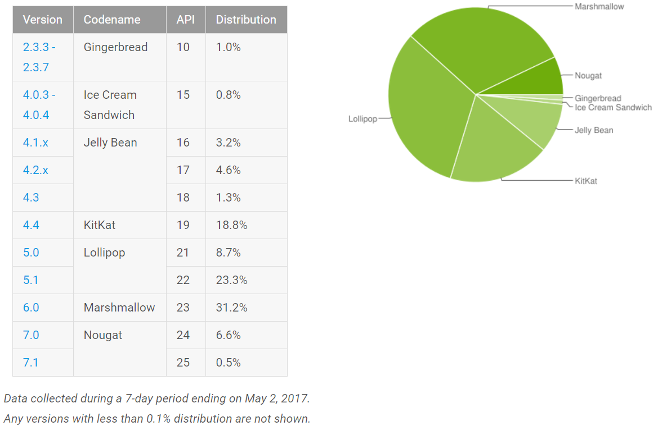
4c. Android issues (today)
OS fragmentation
90.4% of Android devices support BLE
Peripheral mode: 70.2% minus Nexus 4, 5, 7 (2012/2013)
OS < 5.0 not considered reliable

Slide 34
4c. Android issues (today)
Max theoretical speed = 16KiB/s
Nexus 4/6P
20 bytes MTU, 6 packets/connection interval, 7.5ms interval
(20 bytes * 6 ) / 7.5ms = 16KiB/s
Might be different for other phones

Slide 35
4c. Android issues (today)
All callbacks from BLE APIs are not on UI thread.
APIs considered new, some functions are buggy
Frequent connection drops (< 5.0)
Max BLE connections:
Software cap in Bluedroid code: BTA_GATTC_CONN_MAX, GATT_MAX_PHY_CHANNEL
Android 4.3: 4
4.4 - 5.0+: 7
No API callback to indicate scanning has stopped
Scan supposed to be indefinite by API specification, but some phones stop scan after some time
Known offender: Samsung???
Solution: Restart scan at regular intervals
Different scan return result behaviours (See further reading)
Some phones filter advertisement results, some phones do not. (usually on 4.3 and 4.4)
Bugs on (Samsung) phones at least < 5.0
Scan using service UUID filtering does not work -> no results returned
connectGatt() must be called from UI thread
Slow LE initial discovery and connection time
HTC seems to have this issue???
A high-level view on issues collated by Anaren
https://atmosphere.anaren.com/wiki/Android_Issues_With_Bluetooth_Low_Energy
A more comprehensive list of issues has been collated by iDevicesInc
https://github.com/iDevicesInc/SweetBlue/wiki/Android-BLE-Issues
May be able to overcome using: https://github.com/iDevicesInc/SweetBlue
Free for non-commercial use

Slide 36
4c. Tips for production Android app
Use Nexus/Pixel (reference phone) for initial development
Get many models from differing manufacturers

Slide 37
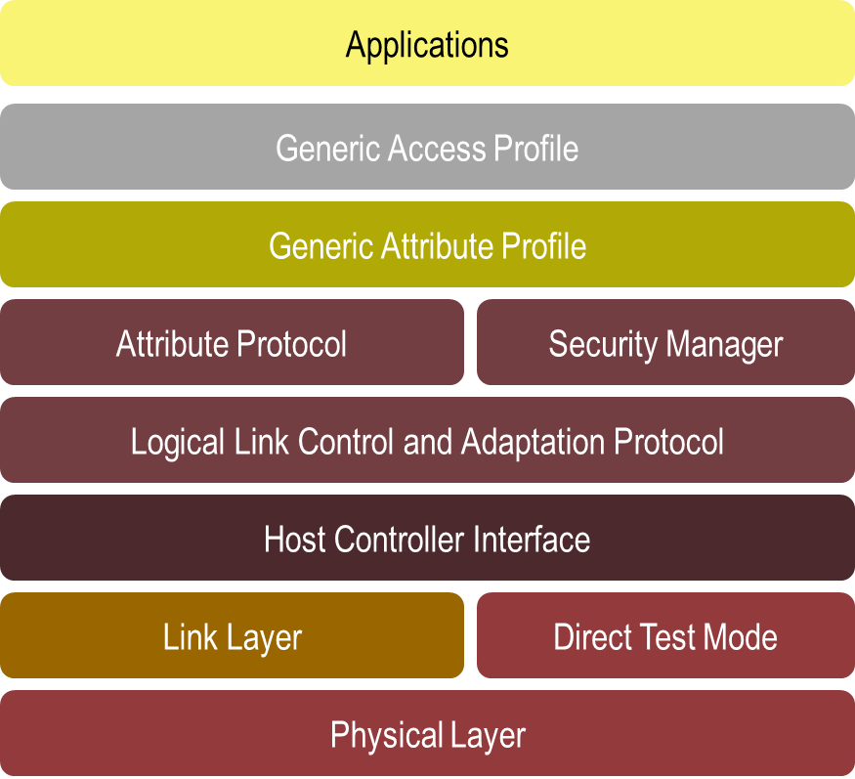
5. BLE layer model
Link-layer:
Defines how two BLE devices communicate. Advertising, Scanning, Connecting, Packet Format
Convention is to use Master/Slave instead of Central/Peripheral
L2CAP:
Segmentation and reassembly of packets
4-byte header
23 bytes for MTU
Protocol multiplexing
0x0004: ATT Channel (usually used)
0x0005: LE signalling
0x0006: Security Manager
ATT
Action to be taken (Read/Write/…)
1-byte instruction opcode
2-byte handle (ID of relevant service/characteristic/descriptor)
20-byte MTU for application
(GAP)
(GATT)
(ATT)
(L2CAP)
(Master/Slave)
Source: https://developer.bluetooth.org/KnowledgeCenter/PublishingImages/GATT_stack.png

Slide 38
5. BLE Data Link-layer Packet Structure
LSB
Protocol/Packet Data Unit (PDU)
Field size (bits) | 8 | 32 | 8 | 8 | 0-296 | 24
Field name | Preamble (Alternating bits for receiver calibration) | Advertising /Data Access Address | Header | Length | Payload | CRC
Only 1 packet structure
Two types of packets
Advertising
Advertising Access Address: Always 0x8E89BED6
Data
Data Access Address: Random for every connection
Allows Master/Slave to distinguish packets associated with a connection
Mac Address no longer used for data packets
Usually carries L2CAP/ATT payload
PDU header format for Advertising != Data

Slide 39
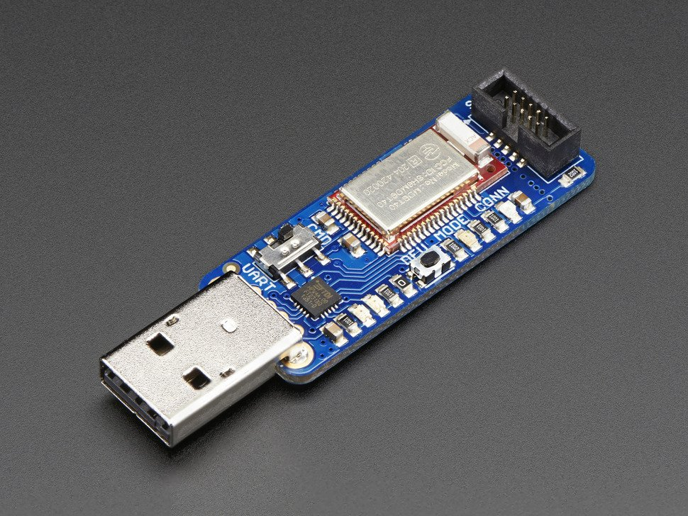
6. BLE Sniffer
Adafruit Bluefruit LE Sniffer
Based on Nordic nRF51822
Required software:
Nordic nRF Sniffer (Windows-only)
Results piped to Wireshark
Alternative: Ubertooth One

Slide 40
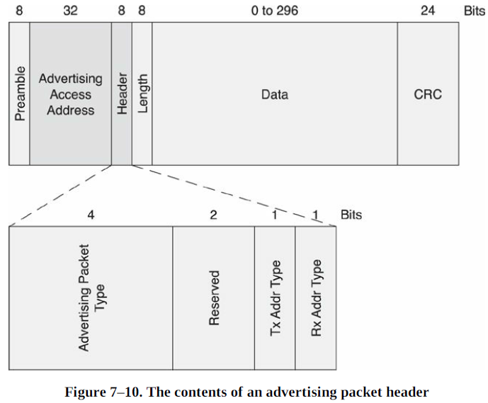
6. Sniffer: Advertising
Link layer format
ADV packets’ payload contains GAP data:
Mac Address
Service UUID
Supported Bluetooth features: Dual/Single mode
TX Power (Optional)
Name (Optional)
PDU/Advertising Type:
4-bit field determines type of ADV Packet
Slave is connectable
0000: ADV_IND (Undirected connectable mode)
No need to connect in a hurry
0001: ADV_DIRECT_IND (Directed connectable mode)
To indicate to master that slave wants to be connected quickly.
Max 1.28s in this mode
Slave is not connectable
0010: ADV_NONCONN_IND (Not scannable)
Will not respond to scan (SCAN_REQ) requests for more info
0110: ADV_SCAN_IND
Will response to SCAN_REQ with SCAN_RSP
0x8E89BED6
Source: BLE: The Developer’s Handbook by Robin Heydon, pg82

Slide 41
6. Sniffer: Scan
ADV Packets may not hold all advertising info
Central can issue SCAN_REQ to ask for more
0011: SCAN_REQ (Active Scan Request)
Master -> Slave
Ask peripheral for complete GAP data
0100: SCAN_RSP (Response)
Slave -> Master
Contains slave’s name, TX power, …

Slide 42
6. Sniffer: Connection
PDU Type:
0101: Connect_REQ (Connect Request)
Master -> Slave
Master selects and sends a random data access address
Link-layer data -> Access address field
0110: Empty PDU (Keep-alive packet)
Sent at connection interval between Master <-> Slave
Filter "not btle.data_header.llid==0001” to ignore in Wireshark

Slide 43
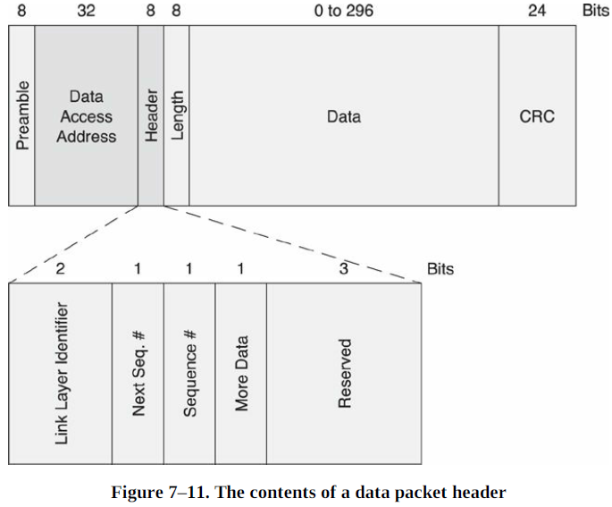
6. Sniffer: Data Packets
Link layer format
Payload usually contains L2CAP/ATT data
Link-layer identifier (LLID) – 2 bits
11 : Control Packet
10 : Start/Full Packet
01: Continuation of fragmented packet
If LLID == 11 (Control Packet)
Header format changes to have control and error fields
Does not contain L2CAP/ATT payload data
0x0c: LL_VERSION_IND: Negotiate supported Bluetooth Spec
0x01: LL_CHANNEL_MAP_REQ: Channel hop (Master -> Slave)
0x02: LL_TERMINATE_IND: Terminate connection
Source: BLE: The Developer’s Handbook by Robin Heydon, pg83

Slide 44
6. Sniffer: Discover services/characteristics
ATT opcodes
0x10: Read by Group Type Request (Discover Services)
Master -> Slave
0x11: Read by Group Type Response
Slave -> Master
Returns Services Requested
0x08: Read by Type Request (Discover Characteristics)
Master -> Slave
0x09: Read by Type Response
Slave -> Master
Returns Characteristics Requested
You may notice some “hidden” services during sniffing
Generic Access Service: 0x1800 (Contains generic info, name, type etc about peripheral)
Generic Attribute Service: 0x1801 (I don’t know what this is)

Slide 45
6. Sniffer: Data transfer
0x52: Write Command (Write to Characteristic)
Master -> Slave
0x1b: Handle Value Notification (Notify Characteristic Changed)
Slave -> Master

Slide 46
7. Further reading
BLE 4.0-4.1 Security (Passive) Weaknesses (19:58 to 23:14)
Video: https://www.usenix.org/conference/woot13/workshop-program/presentation/ryan
Paper: https://lacklustre.net/bluetooth/Ryan_Bluetooth_Low_Energy_USENIX_WOOT.pdf
In-depth introduction by Nordic Semiconductor
https://www.youtube.com/watch?v=BZwOrQ6zkzE
Acceptable types of Characteristic values
https://developer.bluetooth.org/gatt/descriptors/Pages/DescriptorViewer.aspx?u=org.bluetooth.descriptor.gatt.characteristic_presentation_format.xml
BLE Sniffer (by Adafruit)
https://learn.adafruit.com/introducing-the-adafruit-bluefruit-le-sniffer
Android 4.3 BLE unstable
http://stackoverflow.com/questions/17870189/android-4-3-bluetooth-low-energy-unstable
Android different scan results behaviour
http://stackoverflow.com/questions/19502853/android-4-3-ble-filtering-behaviour-of-startlescan
Android 5.0 BLE APIs improvement vs 4.3
https://www.youtube.com/watch?v=qx55Sa8UZAQ
High-level Android Issues collated by Anaren
https://atmosphere.anaren.com/wiki/Android_Issues_With_Bluetooth_Low_Energy
Lower-level Android issues collated by iDevicesInc
https://github.com/iDevicesInc/SweetBlue/wiki/Android-BLE-Issues
BLE Advertising Packet Format
http://j2abro.blogspot.sg/2014/06/understanding-bluetooth-advertising.html
Bluetooth Core (Adopted) Specification
https://www.bluetooth.org/en-us/specification/adopted-specifications
Raspberry Pi 3 UART/Bluetooth issues
http://yeokhengmeng.com/2016/03/raspberry-pi-3-uartbluetooth-issues/

Slide 47
Questions?
By: Yeo Kheng Meng (yeokm1@gmail.com)
https://github.com/yeokm1/intro-to-ble

Slide 48
8a. Can Peripheral prevent unwanted connections from unknown Central?
Not possible to block connection attempt
But peripheral can disconnect the central after connected
Wait for key-exchange
Mac address whitelist
Disconnect APIs
arduino-BLEPeripheral
blePeripheral.disconnect();
Bleno
bleno.disconnect();

Slide 49

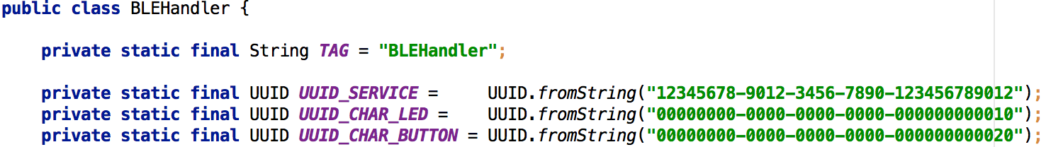
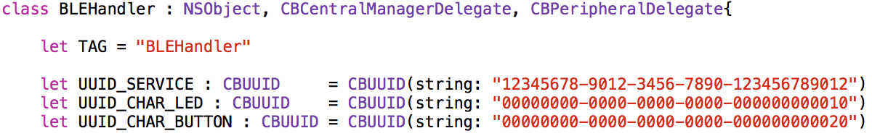
8b. Who defines the attributes?
Peripheral always defines the attributes
Services, characteristics and descriptors
Then why did I do this on the Central?
Android:
iOS:
Reason:
I hardcoded the characteristic UUIDs to address the characteristics directly since I already know their purpose

Slide 50
8c. BLE Security?
Bluetooth pairing
< Bluetooth 4.2:
Strongly discouraged to use native BLE security features Key-exchange protocol weakness
See video in Further Reading
Security issues fixed in 4.2 (Dec 2014)
But many devices/SDK in the market have not adopted this

Slide 51
8d. Data loss from using writeWithoutResponse instead of write property?
Possibility exists but unlikely to happen in practice
Rough Analogy:
write vs writeWithoutResponse -> TCP vs UDP
Possible to lose data if central sends faster than peripheral can process

